Slide 1


TaskXpert - A Unified AI-Powered Agent for Smart Emails, Web Extraction, and Data Visualization
Team Member 1:Harsavardhini R (221801016)
Team Member 2:Kaviya S (221801024)
Team Member 3:Monisha M (221801034)
MENTOR : Dr.S.Suresh Kumar

Slide 2
PROBLEM STATEMENT
In today’s fast-paced digital environment, individuals and professionals often struggle to manage repetitive tasks such as drafting emails, cleaning raw datasets, and extracting useful web information efficiently. Existing tools either focus on a single functionality or require technical expertise, resulting in wasted time and low productivity. There is a pressing need for an integrated, user-friendly platform that automates these tasks using AI and web technologies while ensuring data security and ease of use.

Slide 3
OBJECTIVE
To develop an all-in-one web platform that simplifies common tasks like email creation, data cleaning, and web scraping.
To reduce manual effort and save time by automating repetitive activities using AI and intelligent logic.
To ensure user-friendly interaction with a clean interface that makes the tool accessible to both technical and non-technical users.
To provide secure processing and handling of user data, with a focus on data privacy and confidentiality.
To enable future extensibility by designing the system to easily incorporate additional productivity features.

Slide 4
ABSTRACT
TaskXpert is an AI-powered productivity platform that integrates email generation, web scraping, and CSV data cleaning into a unified web interface. Leveraging the Mistral 7B Instruct model, the system enables users to compose context-aware emails from natural language prompts with manual editing and direct sending capabilities. The platform also supports web scraping to extract useful links from websites and CSV data cleaning using statistical methods, followed by visualizations for insight generation. Built using the MERN stack, TaskXpert offers a secure, scalable, and interactive solution for streamlining digital workflows.

Slide 5
LITERATURE SURVEY
S.No | Author(s) | Year | Technique | Description | Outcome
1 | Smith et al. | 2021 | Web Scraping with Python | Used Python libraries like BeautifulSoup to extract data from websites. | Demonstrated efficient extraction of HTML content and link data.
2 | Liu and Zhang | 2020 | Data Cleaning Algorithms | Explored statistical methods (mean, median, mode) for handling null values. | Improved data quality and analysis readiness.
3 | Jones et al. | 2022 | AI-based Text Generation | Used transformer models for automating email writing. | Generated context-aware and human-like email responses.
4 | Kumar and Singh | 2021 | Full Stack Web Development | Developed a web tool integrating backend logic with a user interface. | Showed seamless integration of multiple functionalities in one platform.
5 | Patel et al. | 2023 | Node.js & MongoDB | Built a secure web app with dynamic data handling using Node and MongoDB. | Enabled real-time data processing with enhanced user privacy.

Slide 6
EXISTING SYSTEM
Most platforms handle only one task at a time (email writing, data cleaning, or web scraping).
Tools like email generators are available but lack context-awareness and personalization.
Data cleaning often requires manual effort or coding knowledge.
Web scraping tools are either too technical or don’t export data in usable formats like CSV.

Slide 7
DRAWBACK OF EXISTING SYSTEM
Lack of integration – Multiple tools needed for different tasks.
Requires technical skills – Not suitable for non-coders.
Time-consuming – Manual processing slows productivity.
Limited intelligence – Poor adaptability to user context or needs.

Slide 8
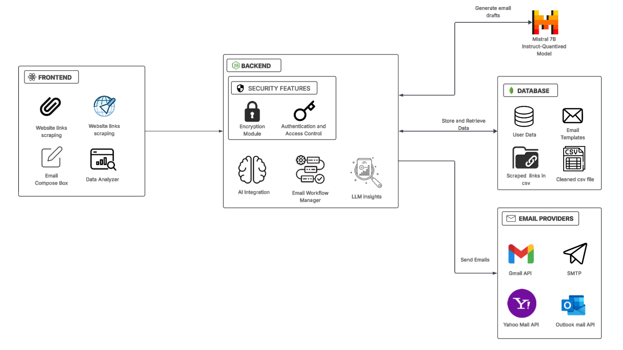
SYSTEM ARCHITECTURE

Slide 9
PROPOSED SOLUTION
Multi-Feature Productivity Platform: Combines email automation, CSV data cleaning, and web scraping in a single web-based tool to streamline daily tasks.
AI-Powered Email Generation: Uses the Mistral 7B Instruct model to generate context-aware, professional emails based on user prompts.
Smart Data Cleaning Module: Automatically handles missing values in uploaded CSV files using mean, median, or mode, improving data quality.
Web Scraping to CSV Converter: Extracts all accessible links from a given website and converts them into a downloadable CSV file with link metadata.

Slide 10
TECHNOLOGY USED
React.js – Used to build a dynamic and responsive frontend interface.
Node.js & Express.js – Handle backend logic, routing, and API integrations.
MongoDB – Stores user data, email history, and task configurations.
Mistral 7B Instruct – Powers AI-generated email content through natural language prompts.
SMTP & Nodemailer – Enable secure email sending across major providers.
Axios & Cheerio – Perform web scraping to extract hyperlinks from web pages.
ml-stat & ChartJSNodeCanvas– Clean CSV data and generate visual insights through charts.

Slide 11
LIST OF MODULES
Email Generation Module
Web Scraping Module
Data Cleaning & Analyzing Module

Slide 12
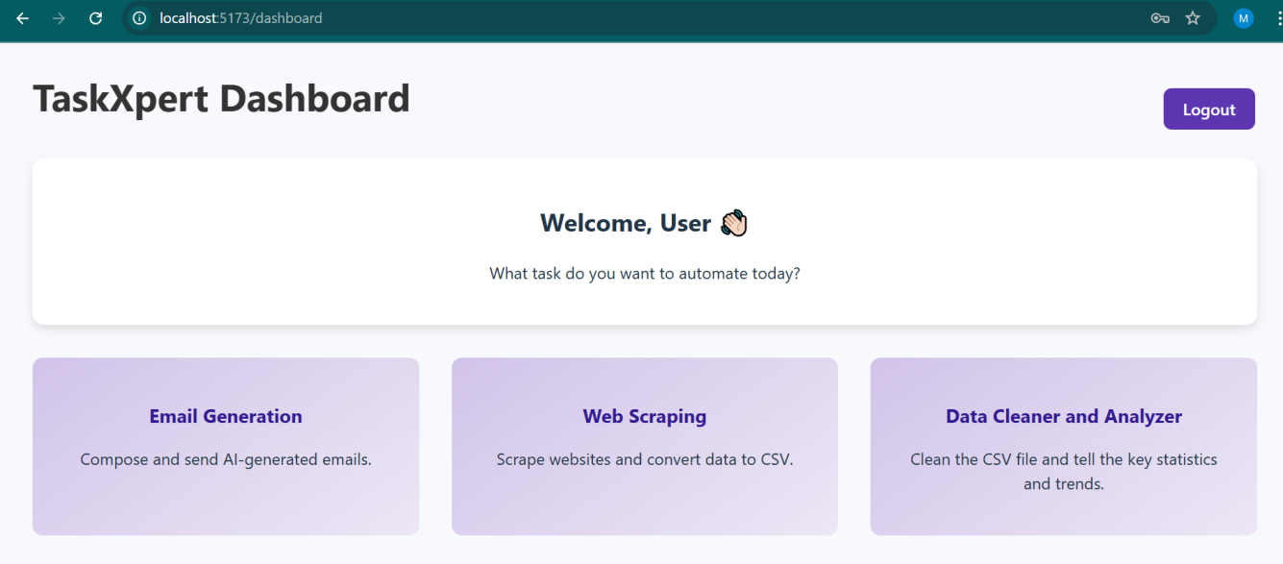
SOLUTION

Slide 13
MODULE 1: Email Generation Module
Purpose: To simplify the process of composing professional emails.
Key Features:
Allows users to enter prompts directly or use extracted text from uploaded images as input.
Uses Mistral 7B AI model for email generation and editable email drafts.
Supports to send the email from the platform itself with the attachments.
Sending supports for all email formats like Gmail,Yahoo,Outlook etc.
Use Cases:
Students emailing professors.
Freelancers drafting client updates.
Employees communicating formally.
Benefit:Saves time and ensures high-quality communication.

Slide 14
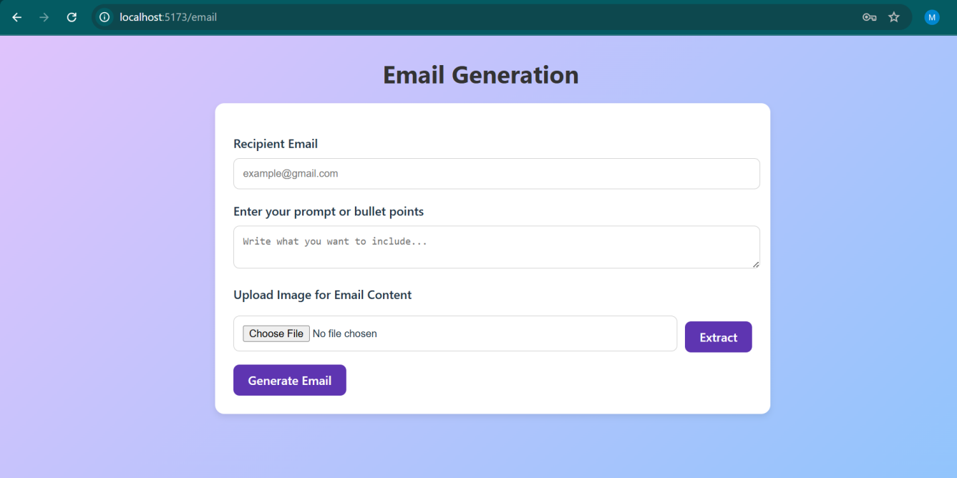
SOLUTION

Slide 15
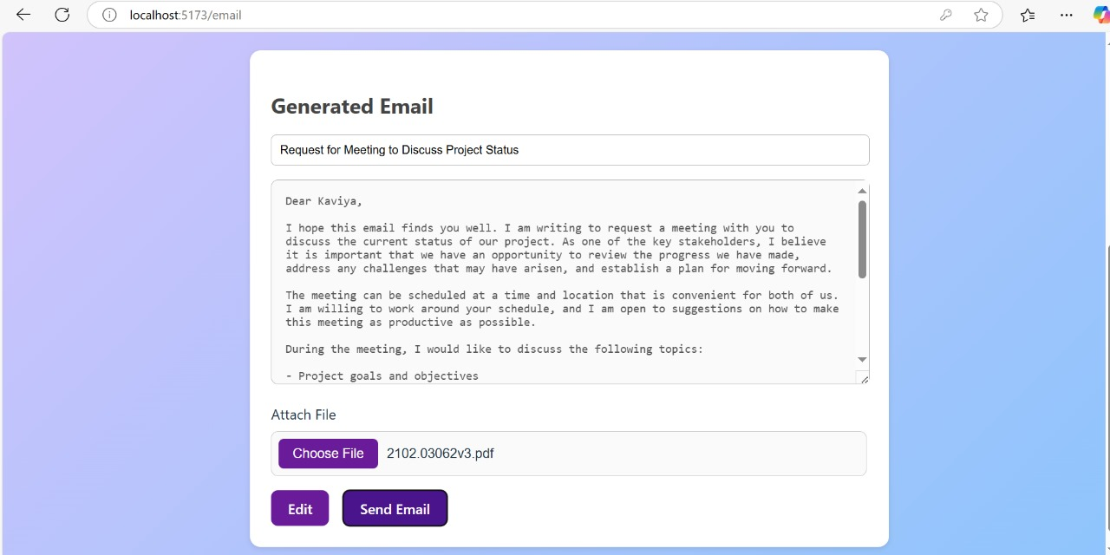
SOLUTION

Slide 16
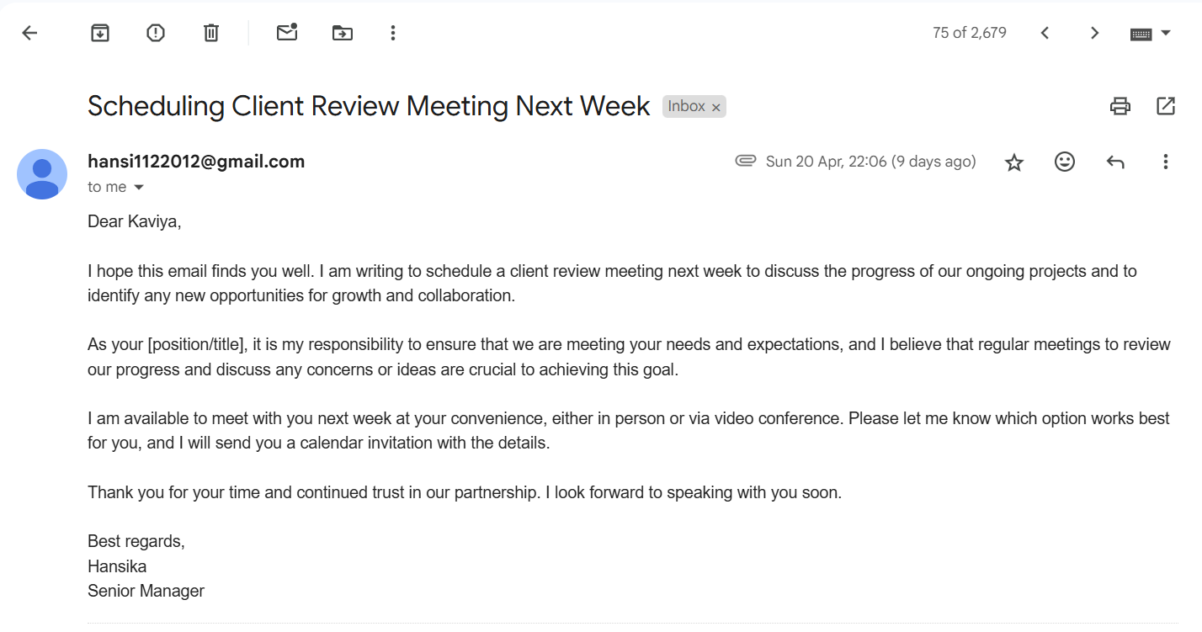
SOLUTION

Slide 17
OUTPUT

Slide 18
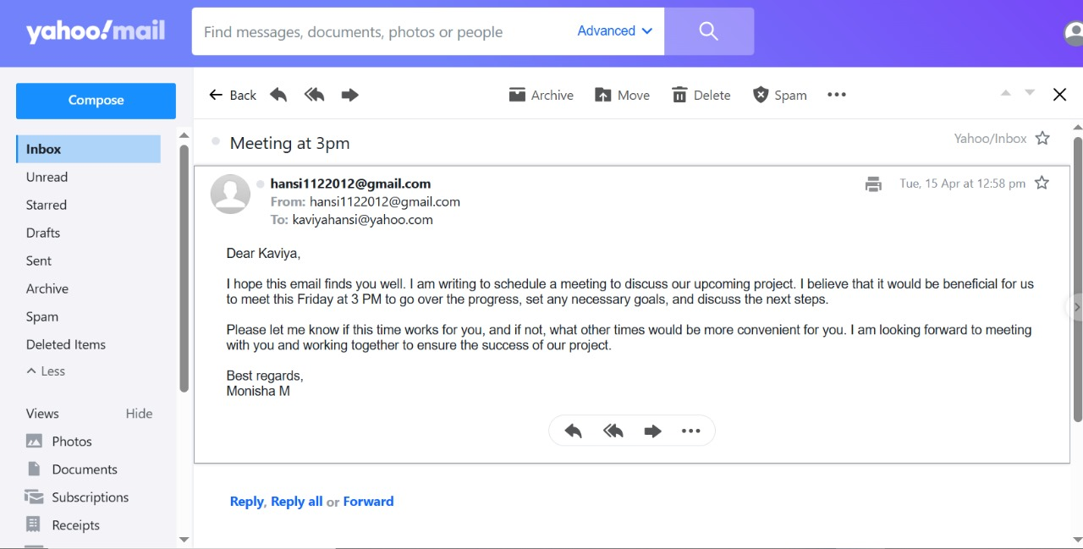
OUTPUT

Slide 19
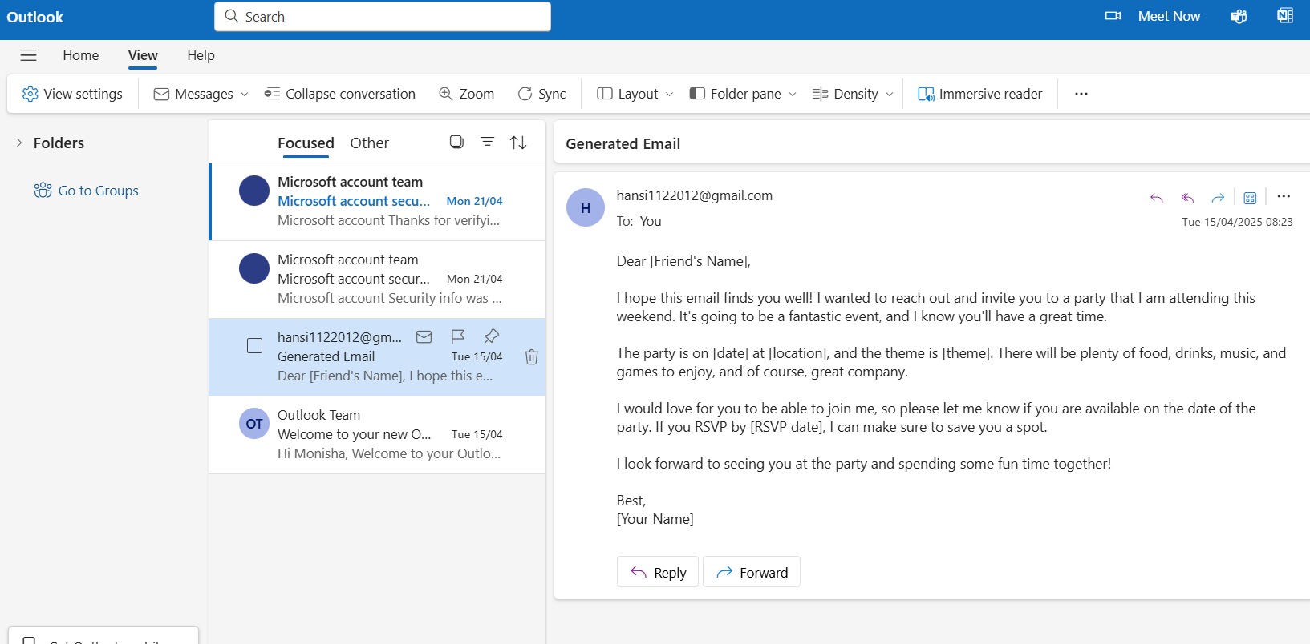
OUTPUT

Slide 20
MODULE 2: Web Scraping Module
Purpose:To extract structured hyperlink data from any webpage.
Key Features:
Accepts a user-provided URL.
Extracts all anchor texts and URLs.
Exports results in CSV format with “Link Name” and “URL” columns.
Use Cases:
Marketers collecting contact links.
Researchers extracting reference sources.
Content aggregators gathering web data.
Benefit: Eliminates manual effort and provides quick results.

Slide 21
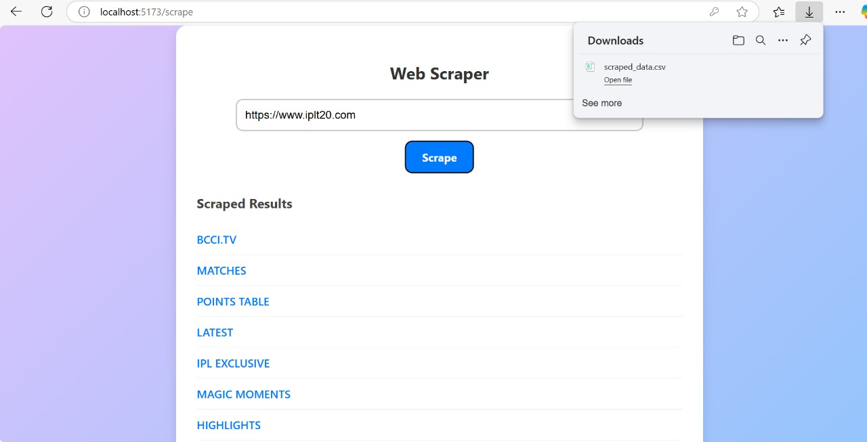
SOLUTION

Slide 22
MODULE 3: Data Cleaning & Analyzing Module
Purpose:To help users preprocess messy data quickly and efficiently.
Key Features:
Upload and analyze raw CSV files.
Fix missing data with mean, median, or mode strategies and removes redundant entries
Get LLM insights for data-driven decision-making.
Get a suitable chart for the dataset based the target feature
Use Cases:
Data analysts preparing datasets.
Researchers cleaning survey data.
Business users working on reports.
Benefit:Accelerates data preprocessing and ensures consistency.

Slide 23
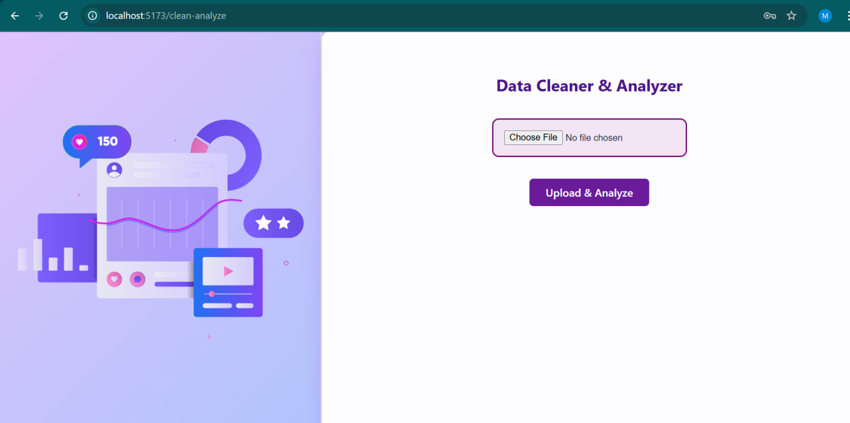
SOLUTION

Slide 24
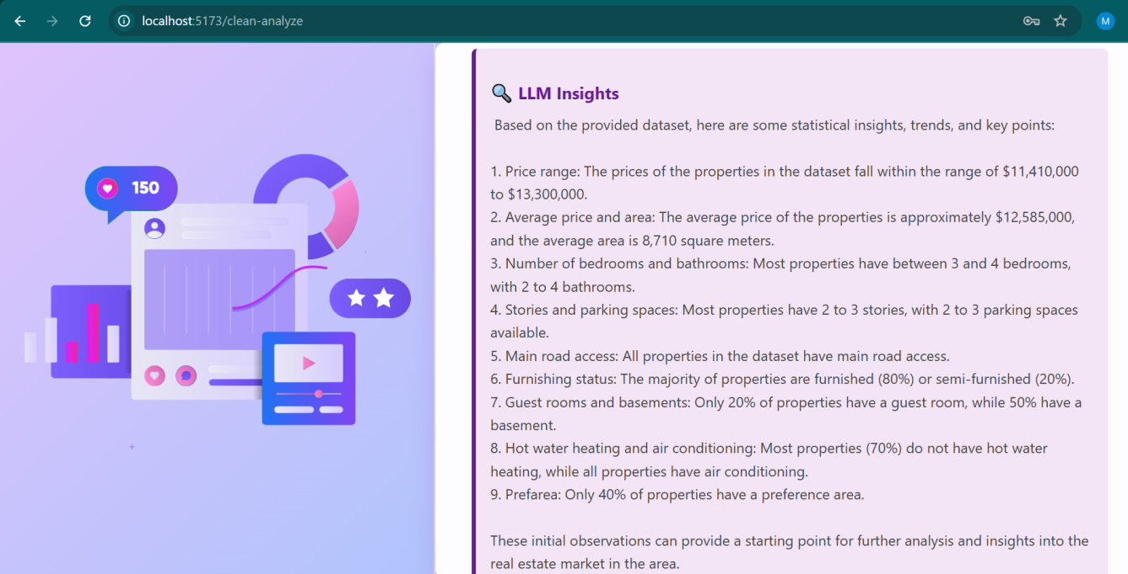
OUTPUT

Slide 25
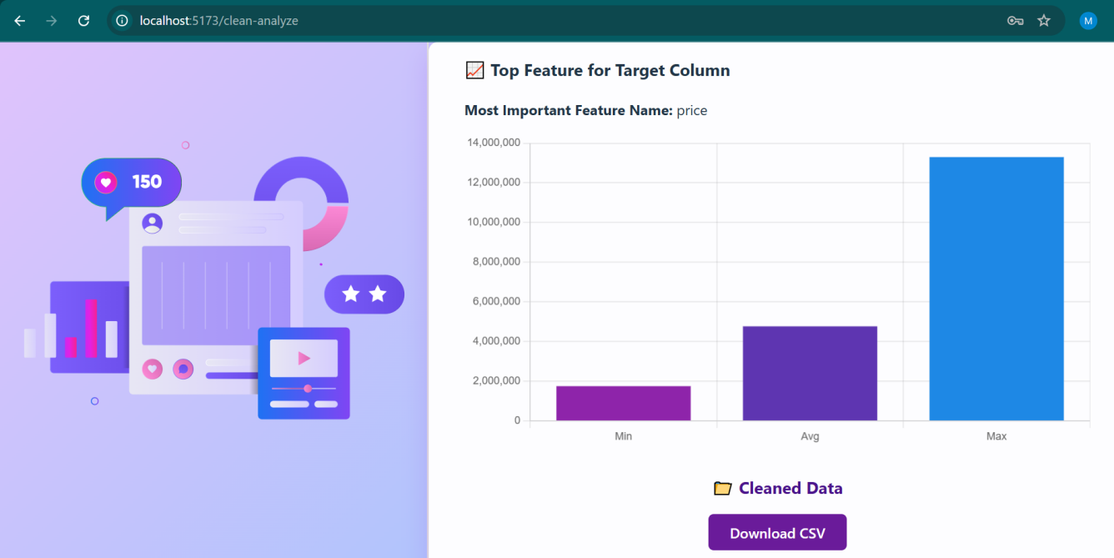
OUTPUT

Slide 26
NOVELTY
AI Email Automation: Uses Mistral 7B Instruct for generating personalized email content, allowing real-time edits and seamless integration with email services.
Web Scraping: Extracts hyperlinks from websites or search queries, providing quick access to valuable data directly within the platform.
CSV Data Cleaning & Visualization: Allows users to clean and visualize CSV data by handling missing values and presenting insights via charts, streamlining data-related tasks.

Slide 27
SOCIAL RELEVANCE
TaskXpert addresses key challenges in digital communication and data management. By streamlining email composition with AI, it saves time and reduces the cognitive load for professionals, fostering more efficient communication.
The web scraping feature helps users quickly access relevant online information, improving research and decision-making processes.
Additionally, the CSV data cleaning and visualization tools make handling large datasets easier, aiding in data-driven decision-making.
Overall, TaskXpert enhances productivity, supports data privacy, and empowers users to manage communication and information more effectively in today's fast-paced digital world.

Slide 28
CONCLUSION
TaskXpert successfully integrates AI-powered email generation, smart data cleaning, and web scraping into one seamless platform, enhancing productivity and reducing manual effort. Its user-friendly design, secure processing, and modular architecture make it a reliable tool for professionals and students alike. The project demonstrates how intelligent automation can simplify complex workflows, offering a scalable foundation for future enhancements.

Slide 29
REFERENCES
[1]Loukili, Soumaya & Fennan, Abdelhadi & Lotfi, Elaachak. (2024). Email subjects generation with large language models: GPT-3.5, PaLM 2, and BERT. International Journal of Electrical and Computer Engineering (IJECE) , 2024.
[2]S. Bhosale, R. Dhumal, V. Patkar and T. P. Singh, "Use Of RPA For Email Automation With Salesforce Integration," 2023 IEEE 5th International Conference on Cybernetics, Cognition and Machine Learning Applications (ICCCMLA), Hamburg, Germany, 2023.
[3]G. Jagnade, S. Sable and M. Ikar, "Streamlining Email Workflow: Empowering Users with Voice Recognition Technology and Website-Email Autometa Solutions," 2023 14th International Conference on Computing Communication and Networking Technologies (ICCCNT), Delhi, India, 2023.
[4]S. Ghalme, K. Shelke, R. Kadam and U. Tupe, "Automated Emails and Data Segregation using Python," 2023 International Conference on Sustainable Computing and Smart Systems (ICSCSS), Coimbatore, India, 2023.
[5]M. N. Dandale, Mazharunnisa, D. J. J. D. Daniel, R. S. Priya, M. A. A. Walid and T. T, "Business Process Automation using Robotic Process Automation (RPA) and AI Algorithm’s on Various Tasks," 2023 8th International Conference on Communication and Electronics Systems (ICCES), Coimbatore, India, 2023.

Slide 30
REFERENCES
[6]C. Sathish, A. Mahesh, N. S. Karpagam, R. Vasugi, J. Indumathi and T. Kanchana, "Intelligent Email Automation Analysis Driving through Natural Language Processing (NLP)," 2023 Second International Conference on Electronics and Renewable Systems (ICEARS), Tuticorin, India, 2023.
[7]A. Khare, S. Singh, R. Mishra, S. Prakash and P. Dixit, "E-Mail Assistant – Automation of E-Mail Handling and Management using Robotic Process Automation," 2022 International Conference on Decision Aid Sciences and Applications (DASA), Chiangrai, Thailand, 2022 .
[8]Jonas Thiergart, Stefan Huber, Thomas Übellacker, “Understanding Emails and Drafting Responses -- An Approach Using GPT-3”, 2021 .
[9]S. Manikantam, P. Akhil, K. R. A. Reddy, G. S. P. Reddy, S. Hariharan and V. Kekreja, "Enhanced automated web scraping tool with proliferation of AI techniques," 2024 International Conference on Innovations and Challenges in Emerging Technologies (ICICET), Nagpur, India, 2024 .
[10]A. Abodayeh, R. Hejazi, W. Najjar, L. Shihadeh and R. Latif, "Web Scraping for Data Analytics: A BeautifulSoup Implementation," 2023 Sixth International Conference of Women in Data Science at Prince Sultan University (WiDS PSU), Riyadh, Saudi Arabia, 2023

Slide 31
THANK YOU

